Slide 1
Advanced Encryption Standard(AES)
This is the latest standard that is ruling the world.
In the classical Feistel structure, half of the data block is used to modify the other half of the data block and then the halves were swapped.
In AES, instead processes the entire data block as a single matrix during each round using substitution and permutation.

Slide 2
Abstract Algebra
Group
Ring
field
Finite fields

Slide 3
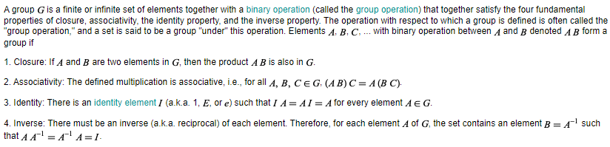
Group

Slide 4
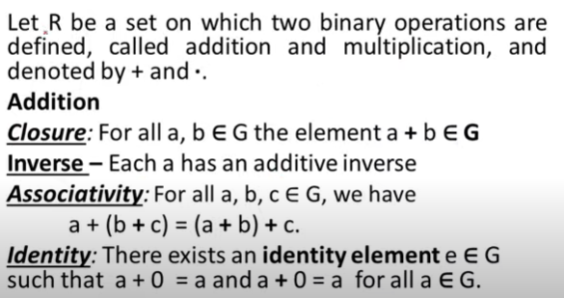
Ring

Slide 5
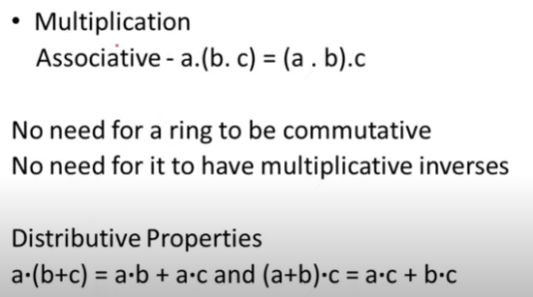
Ring

Slide 6
Field

Slide 7
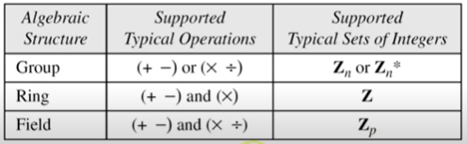

Slide 10
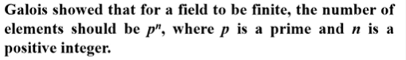
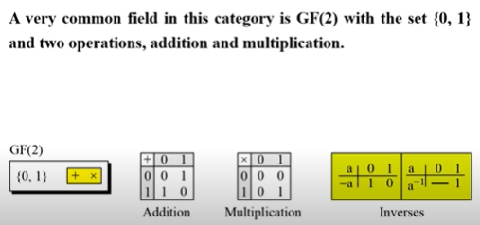
Finite Field

Slide 11
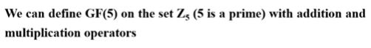

Slide 13
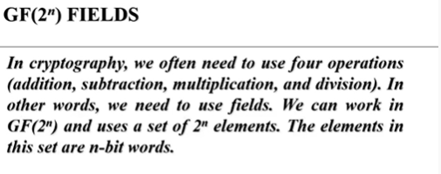

Slide 14
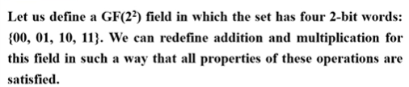
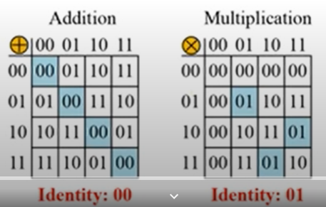

Slide 17
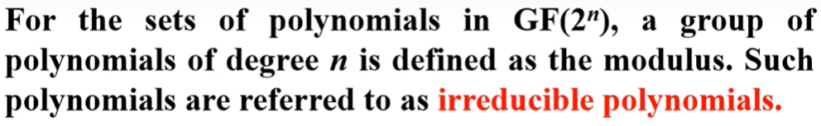
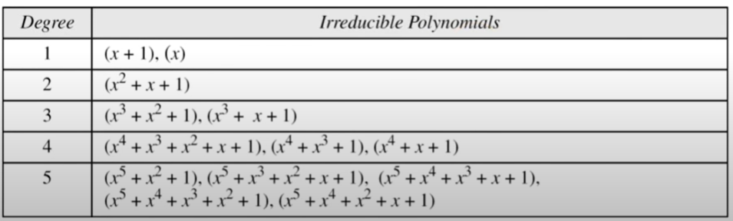
Modulus

Slide 18
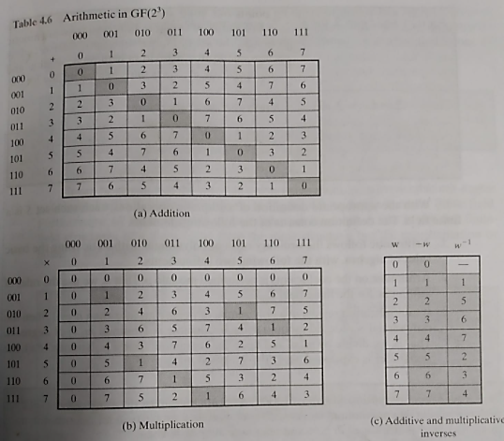

Slide 19
